Slide 1

Chapter 14:
Architectures for
Machine Learning

Slide 2

Background Required to Understand this Chapter
In-Order Pipelines
C++ Programming
Basic Parallel Programming
Chapters 6 and 9
The presentations uses various images licensed under the CC-SA licenses

Slide 3

1.
Basics of Deep Learning
2.
Design of a CNN
3.
Intra-PE Parallelism
4.
Optimizations
5.
The Memory System

Slide 4


Function Estimator
inputs
Function
outputs
We do not know what this function is
We just know the set of outputs for a given set of inputs
Examples: A face recognizer, speech recognizer, object recognizer, a movie recommender, etc.
What is this function?

Slide 5






Some Simple Ideas
Analyze the input-output patterns and make a good guess.
This is quite difficult.
Perform curve fitting.
Not possible for large multi-dimensional data.
Need to know the form of the function.

Slide 6


Can we design a universal approximator?
We do not know the form of the function. We don’t know whether it is linear, nonlinear, exponential, etc.
If there are multiple variables
Could be linear for a few
Nonlinear for a few more.
It is impossible to capture so many patterns a priori.
We need a universal approximator. A master function that can
approximate any function.

Slide 7
Properties of a Universal Approximator
Parameters
inputs
Function
outputs
The parameters should completely control the behavior of the function.
Should be able to approximate any continuous function
Can capture both linear and nonlinear behavior

Slide 8
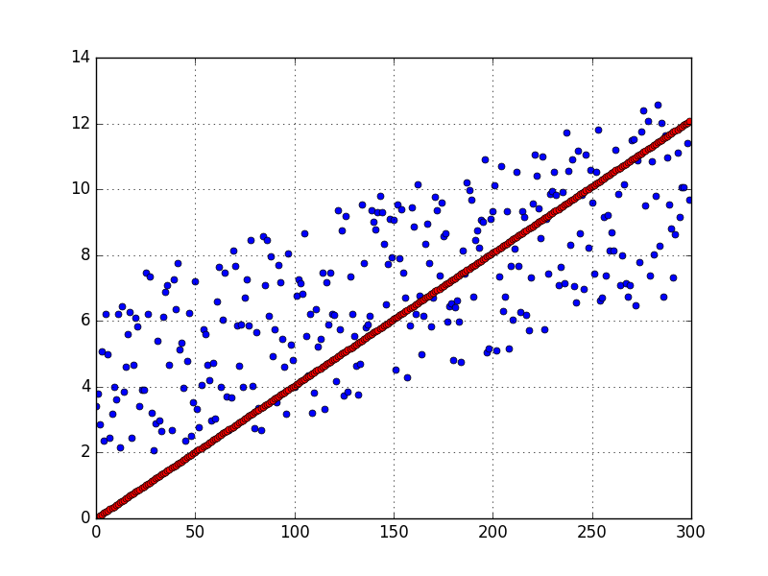
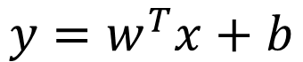
Linear Regression
$$y=w^{T}x+b$$
x is a column vector
w is a vector of weights
b is a bias

Slide 9
Support Vector Machines
Separating plane
Assume it is hard to separate the red and blue points
We project them to a high-dimensional space
Draw an imaginary hyperplane that cleanly separates the two sets of points
They hyperplane is characterized by the points that lie the closest to it → support vectors

Slide 10
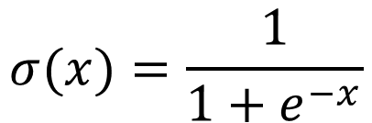
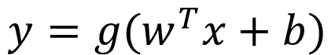
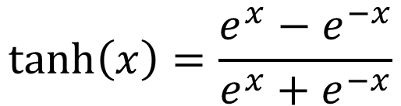
Nonlinear Models
$$y=g(w^{T}x+b)$$
The function g is typically one of the following functions.
Sigmoid function
$$σ(x)=\frac{1}{1+e^{−x}}$$
tanh function
$$\tanh\left(x\right)=\frac{e^{x}−e^{−x}}{e^{x}+e^{−x}}$$

Slide 11
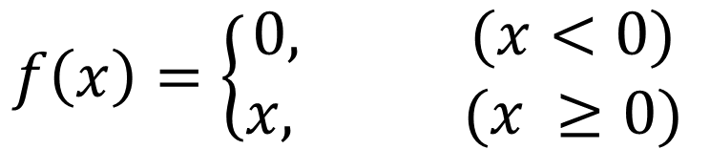
The ReLU Function
The Sigmoid and tanh functions are hard to compute in hardware. We need a simpler function.
$$f\left(x\right)=\left\{\begin{aligned}0, (x<0) \\ x, (x ≥0)\end{aligned} \right.$$
Rectified Linear Unit

Slide 12
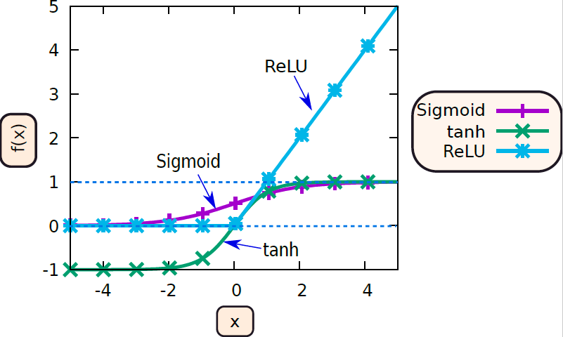
Visualization of all three functions

Slide 13

Example
Given two Boolean inputs, a and b, can you implement the XOR function.
This is a nonlinear function. No linear combination of inputs can produce
the output of the XOR function.
Insights:
(a-b) is the correct output when a=b
Otherwise |a-b| is the correct output
How do we compute |x|?
Answer:
ReLU(x) + ReLU (-x)

Slide 14
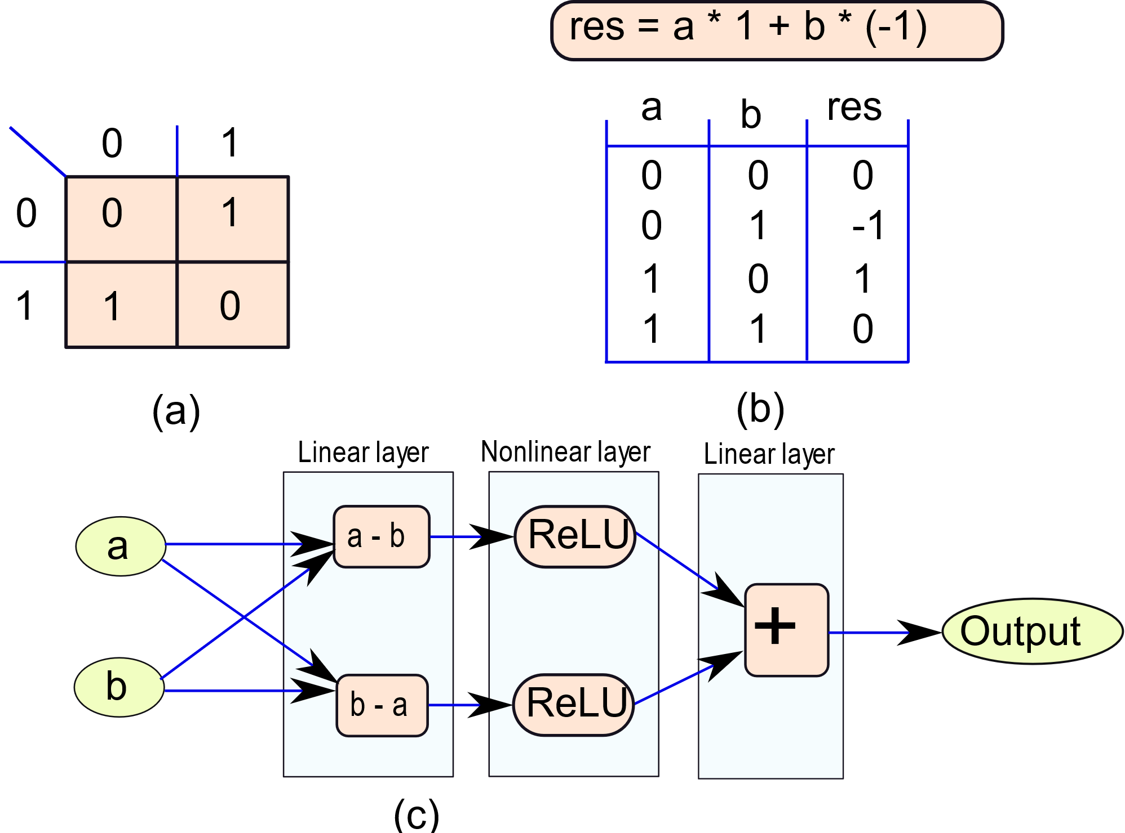
Truth table
a - b
The nonlinear layer is essential

Slide 15

Key Insights
It was necessary to sandwich a nonlinear layer between two linear layers.
Two consecutive linear layers are equivalent to a single linear layer.
This is an example of a neural network
We can on these lines create a deep neural network with a large number of layers and parameters per layer
Parameter → weights and biases

Slide 16
Extend the Idea: Deep Neural Network
Inputs
This is an example of a feed-forward neural network
One layer feeds intermediate results to the one in front of it
We can hundreds of such layers: linear and nonlinear
We can also add skip connections and back edges

Slide 17
Training and Inferencing in a DNN
A modern deep neural network can have hundreds of layers and millions of weights.
They can be used for all kinds of things:
Face detection, speech recognition, recommending movies and videos, finding credit card frauds, etc.
To train such a neural network we need a large amount of golden data (input-output pairs)
The backpropagation algorithm is used to train neural networks
Key idea: Try to adjust the weights such that the output of the neural network is as close to the test output as possible.
The key operation that is implemented in hardware is inferencing
Given an input, compute the output

Slide 18

Why are neural networks “hot” now?
The basic mathematics was developed at least two decades ago.
Why did they catch traction after 2016?
Reason:
The hardware did not exist to process such large neural networks
There were no GPUs, fast FPGA boards, and such affordable HPC (high-performance computing) facilities
On-chip memory and off-chip storage space were limited
Large datasets for training such neural networks did not exist. Cloud computing had to come first to create the data and the market.
Finally, there was no market need

Slide 19
CNNs

Slide 20
Convolutional Neural Networks: CNNs
Basic Terminology
Input feature map or ifmap: Input to a functional unit (FU) in a layer. Typically, a 2D matrix.
Output feature map or ofmap: Output of a functional unit.
A layer has multiple functional units. Each functional unit takes several ifmaps as input and generates an output ofmap. Typically, a 2D matrix.
Each entry of the ifmap/ofmap is called a pixel.
FU
ifmaps
ofmap

Slide 21
Types of Layers
Nonlinear layers:
Pooling layers: Divide the ifmap into groups of K×K pixels.
Compute the maximum value of each group [Max pooling]
Set the corresponding pixel in the ofmap with the maximum value
Alternatively, we can compute the mean value [Average pooling]
Advantage: Corrects for small shifts in the image.
ReLU layers: Compute the ReLU function for each pixel.
Provide a degree of nonlinearity

Slide 22
Fully Connected Layer
w^{T}x + b
The fully connected (FC) layer computes a linear function (mostly a dot product) over all the pixels in an ifmap or a set of ifmaps.
Very expensive in terms of computational requirements.
Large memory requirement because we need to store 1000s/millions of weights. #weights (w) = #inputs (x)
We cannot afford many such layers (too much of time and energy)
The FC layer is typically the last layer in a CNN and we make it produce very few values (typically only the class label)
FC layer
ifmaps
single integer
Computes a dot product

Slide 23

Convolutional Layer
This is the most important layer in a CNN.
We cannot have many FC layers. We need a computationally-efficient approximation.
Solution:
Use a small set of weights known as a filter or a kernel.
Each kernel is used to detect a specific feature.
If we are trying to classify the image of an animal
First detect the smaller features such as horns, ears, teeth, etc.
Combine them into larger features in later layers
Keep doing so until a decision is made in the last layer.

Slide 24
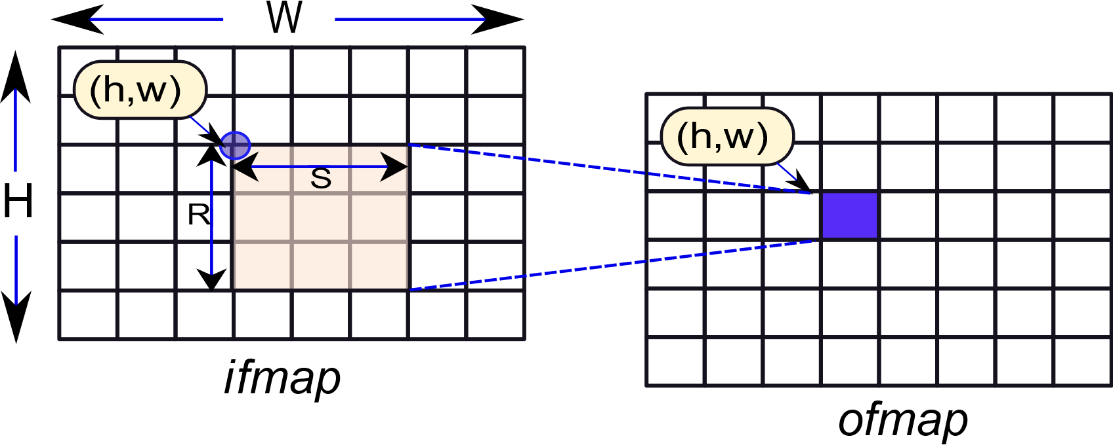
Basic Idea of the Convolution Operation
ifmap filter = ofmap
Consider an R × S element filter
For each position (h,w) of the ifmap compute a dot product with the filter. Set the (h,w)^{th} pixel of the ofmap
Dot product of two matrices:
Compute the elementwise products
Add all of them

Slide 25
A Convolution FU (Functional Unit)
ifmap 1
Convolution block
filter 1
ofmap
ifmap C
Convolution block
Output feature map of an FU
filter C
Add all the convolution results

Slide 26

Discussion
The filter remains the same
It is typically quite small
3 × 3, 5 × 5, or 7 × 7
Convolution operations for different ofmap pixels are mutually independent
Convolutions at the right and bottom edges will remain incomplete.
Assume 0-padding (0-valued pixels) at the right and bottom edges

Slide 27

Summary
A CNN is a feed-forward network
The layers are organized as a linked list (one after the other)
Inputs
It has both linear and non-linear layers
The final output is typically an integer: classification label
We never have two linear layers one after the other
The fully connected (FC) layer is too computational heavy
Replace it with a lighter version: Convolution layer
Both are linear layers. The FC layer is typically the last layer.

Slide 28
Summary – II
Conv. Layer
ifmap 1
FU 1
ofmap 1
ifmap 2
ifmap C
FU K
ofmap K
C inputs
K outputs
We need CK filters: one for each ifmap, ofmap pair
A conv. layer takes as input C ifmaps and produces K ofmaps

Slide 29
1.
Basics of Deep Learning
2.
Design of a CNN
3.
Intra-PE Parallelism
4.
Optimizations
5.
The Memory System

Slide 30
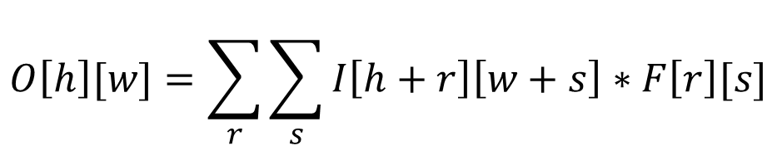
Mathematical Representation of a Convolution
w
ifmap I
Filter F
h
1 output pixel
O[h][w]
Coordinates in the 3x3 filter and the pink window
$$O\left[h\right][w]=\sum_{r}{\sum_{s}{I\left[h+r\right]\left[w+s\right]∗F\left[r\right][s]}}$$

Slide 31
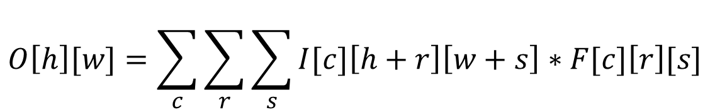
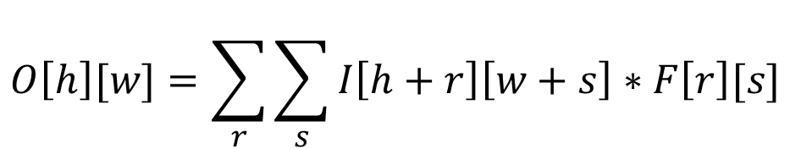
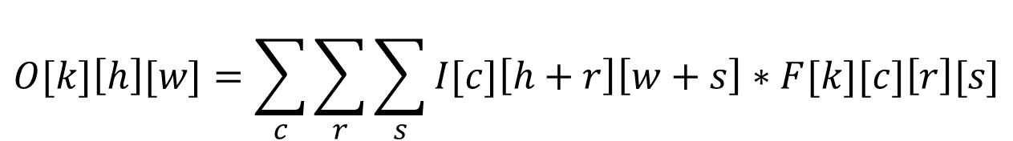
Evolution of the Equation
$$O\left[h\right][w]=\sum_{r}{\sum_{s}{I\left[h+r\right]\left[w+s\right]∗F\left[r\right][s]}}$$
Basic Equation
Effect of multiple channels (c), single ofmap
$$O\left[h\right][w]=\sum_{c}{\sum_{r}{\sum_{s}{I[c]\left[h+r\right]\left[w+s\right]∗F[c]\left[r\right][s]}}}$$
Effect of multiple channels (c), multiple ofmaps (k)
$$O[k]\left[h\right][w]=\sum_{c}{\sum_{r}{\sum_{s}{I[c]\left[h+r\right]\left[w+s\right]∗F[k][c]\left[r\right][s]}}}$$

Slide 32
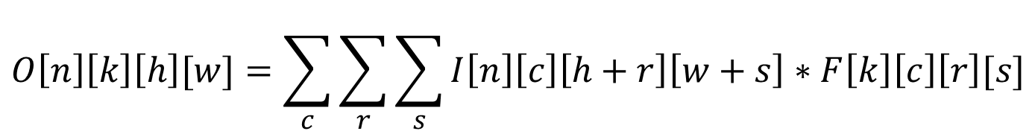
Convolution in its Full Glory: Add multiple images
$$O\left[n\right]\left[k\right]\left[h\right][w]=\sum_{c}{\sum_{r}{\sum_{s}{I\left[n\right]\left[c\right]\left[h+r\right]\left[w+s\right]∗F\left[k\right]\left[c\right]\left[r\right][s]}}}$$
Variable | Symbol | Iterator
Number of input images (matrices) | N | n
Number of input channels | C | c
Number of ofmaps produced | K | k
Dimensions of the ifmaps/ ofmaps | H × W | h and w
Dimensions of the filter | R × S | r and s
We consider a batch of N images
Each ofmap is produced from C ifmaps
There is a separate filter for each ifmap-ofmap pair

Slide 33

The Classic 7-Loop Structure
for (n=0; n<N; n++) { /* input images */
for (k=0; k<K; k++) { /* outputs */
for (c=0; c<C; c++) { /* input channels */
for (h=0; h<H; h++) { /* rows of the ifmap / ofmap */
for (w=0; w<W; w++) { /* cols of the ifmap / ofmap */
for (r=0; r<R; r++) { /* rows of the filter */
for (s=0; s<S; s++) { /* cols of the filter */
O[n][k][h][w] += I[n][c][h+r][w+s] * F[k][c][r][s];
}}}}}}}
Note that this is just a sum of products. The partial products
can be computed independently.

Slide 34
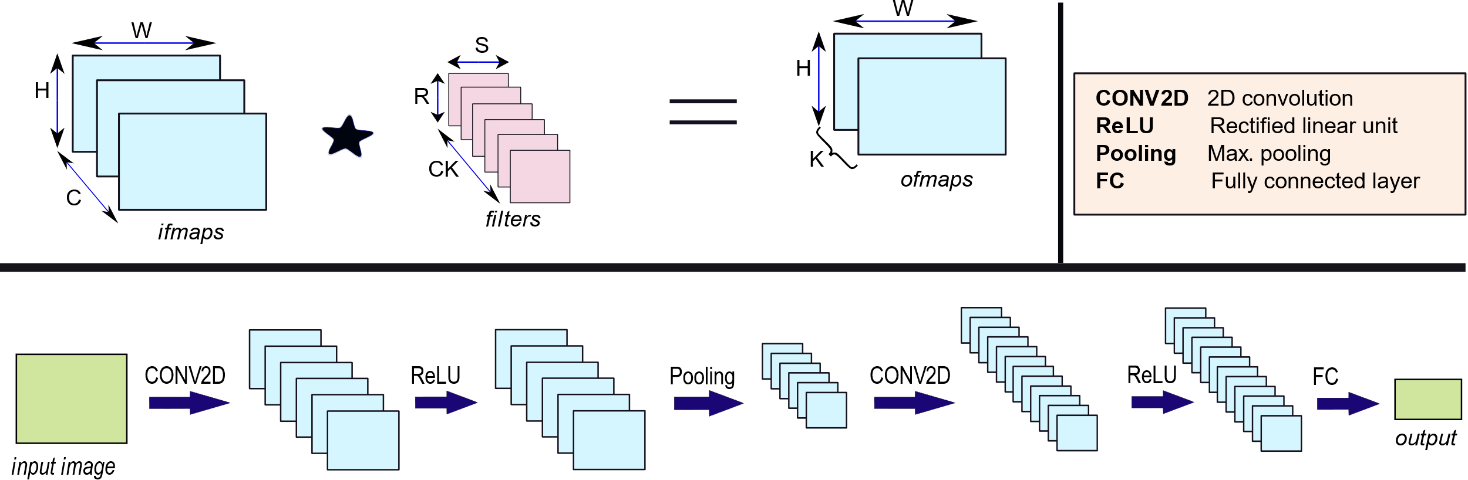

Example: Structure of a CNN with Multiple Layers
Example
We can have hundreds of layers with millions of weights.

Slide 35
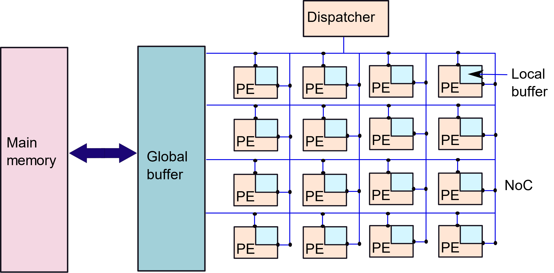
Reference Architecture for a CNN
We have an array of PEs.
Each PE has a local buffer
They are connected via an NoC.
There is a shared global buffer.
This is connected to a large off-chip memory.

Slide 36
Formal Representation of the Nested Loops
In the 7-loop structure, loops can be reordered.
Their ordering is important
Determines the order of accesses and the locality
Determines the cache, NoC, and memory behavior
We can further tile the loops
Opportunity for controlling the locality
Any loop iterator can be tiled
See Chapter 5

Slide 37
Tiled Loops
Tiling
for (n=0; n<N; n++) { /* input images */
for (k=0; k<K; k++) { /* outputs */
for (c=0; c<C; c++) { /* input channels */
for (h1=0; h1<H; h1+= Th) { /* rows of the ifmap / ofmap */
for (w1=0; w1<W; w1 += Tw) { /* cols of the ifmap / ofmap */
for (r=0; r<R; r++) { /* rows of the filter */
for (s=0; s<S; s++) { /* cols of the filter */
for (h2=h1; h2< h1 + Th; h2++) {
for (w2=w1; w2< w1 + Tw; w2++) {
O[n][k][h2][w2] += I[n][c][h2+r][w2+s] * F[k][c][r][s];
}}}}}}}}}
Iterating within a tile

Slide 38

Formal Representation – II
We need a method to
Specify the order of loops
Specify the nature of tiling
Specify the data locality (what is cached in the local buffers (LBs))

Slide 39
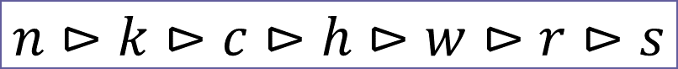
Example of the Formal Notation
for (n=0; n<N; n++) { /* input images */
for (k=0; k<K; k++) { /* outputs */
for (c=0; c<C; c++) { /* input channels */
for (h=0; h<H; h++) { /* rows of the ifmap / ofmap */
for (w=0; w<W; w++) { /* cols of the ifmap / ofmap */
for (r=0; r<R; r++) { /* rows of the filter */
for (s=0; s<S; s++) { /* cols of the filter */
O[n][k][h][w] += I[n][c][h+r][w+s] * F[k][c][r][s];
}}}}}}}
$$n⊳k⊳c⊳h⊳w⊳r⊳s$$
Captures the sequential ordering of loops in software

Slide 40
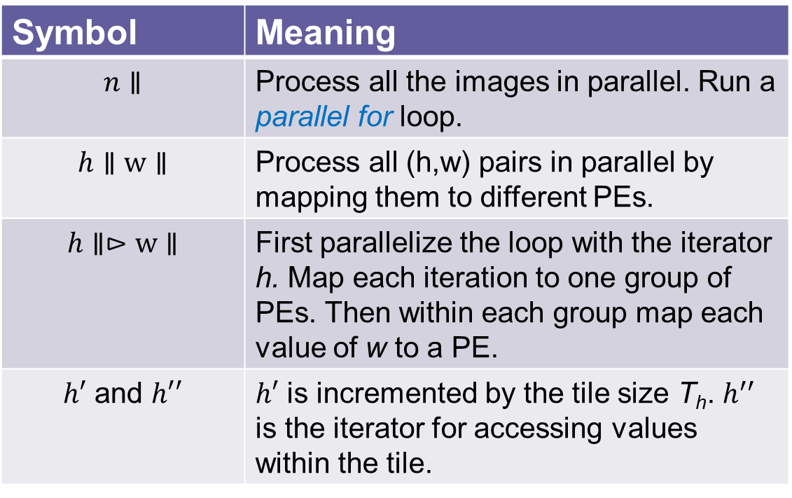
Parallelism and Tiling
Symbol | Meaning
$$n∥$$ | Process all the images in parallel. Run a parallel for loop.
$$h∥w∥$$ | Process all (h,w) pairs in parallel by mapping them to different PEs.
$$h∥⊳w∥$$ | First parallelize the loop with the iterator h. Map each iteration to one group of PEs. Then within each group map each value of w to a PE.
$h′$ and $h′′$ | $h′$ is incremented by the tile size T_{h}. $h^{′′}$ is the iterator for accessing values within the tile.
Execution folding: If we have more iterations than the number of PEs, then we will process a set of iterations, then process the next set, and so on.

Slide 41


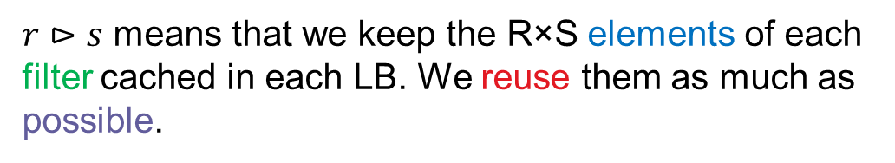
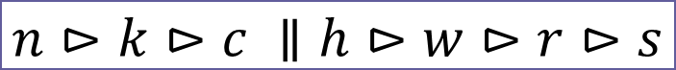
Tiling and Caching
Representation of our example that has tiled execution.
$$n⊳k⊳c⊳h^{′}⊳w^{′}⊳r⊳s⊳h^{′′}⊳w′′$$
Consider the following mapping:
$$n⊳k⊳c ∥h⊳w⊳r⊳s$$
$r⊳s$ means that we keep the R×S elements of each filter cached in each LB. We reuse them as much as possible.

Slide 42
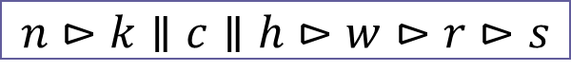
Weight-Stationary Architecture (WS)
Reuse filter weights as much as possible. The row-column iterations are parallelized.
We need to reload images several times.
$$k⊳c⊳n⊳h^{′}∥w^{′}∥h^{′′}⊳w^{′′}⊳r⊳s$$
A different kind of mapping that does not reload images. Parallelize on the basis of the input-output channels.
$$n⊳k∥c∥h⊳w⊳r⊳s$$
Process one image at a time.
Keep the filter weights cached

Slide 43
Input Stationary (IS) Architecture
$$n⊳h^{′}∥w^{′}∥k⊳r⊳s⊳c⊳h^{′′}⊳w′′$$
Process one image at a time
Distribute the rows and columns of the ifmap/ofmap data across the PEs.
Tile the row and column iteration spaces.
Each PE stores C tiles of input data. It can compute all the convolutions.
Note that a tile should actually be of size (T_{h} + R – 1) × (T_{W} + S – 1). Otherwise, we need to communicate values for computing the convolutions for the right and bottom edges.
These are known as halo pixels

Slide 44
Output Stationary (OS) Architecture
$$n⊳h^{′}∥ w^{′}∥c⊳r⊳s⊳k⊳h^{′′}⊳w′′$$
Tile the iteration space in the same manner as the IS architecture
Each PE computes all the ofmaps for the given tile
We stream in the inputs
Again, we need to take care of halo pixels

Slide 45
Row Stationary (RS) Architecture
$$n⊳k⊳c⊳h^{′}∥r^{′}∥h^{′′}⊳r′′⊳w⊳s$$
Distribute rows of the filter and ifmaps to the PEs
Each PE computes partial sums for a set of rows
These values (partial sums) are communicated across the PEs

Slide 46
Hardware Architectures

Slide 47

Temporal and Spatial Reuse
There are two methods of data reuse.
Temporal reuse : We load some data into the LBs. We keep reusing it as much as possible.
Spatial reuse: After producing a partial output or after loading some data, we do not write it back or discard it immediately. We instead keep passing it to other PEs.
We will use the same notation that we used for software. It will specify the parallelism, the order of computation, the tiling and caching.
May not capture all aspects of the data flow.

Slide 48
Broadcast and Systolic Transfer
Broadcast →
Send values to all the PEs in the same cycle.
Easy to implement
Hard to guarantee the timing if we have a lot of PEs
There might be a small amount of clock skew
Systolic Transfer →
Send data to the neighboring PE at the clock cycle boundary.
Does not require tight synchronization

Slide 49
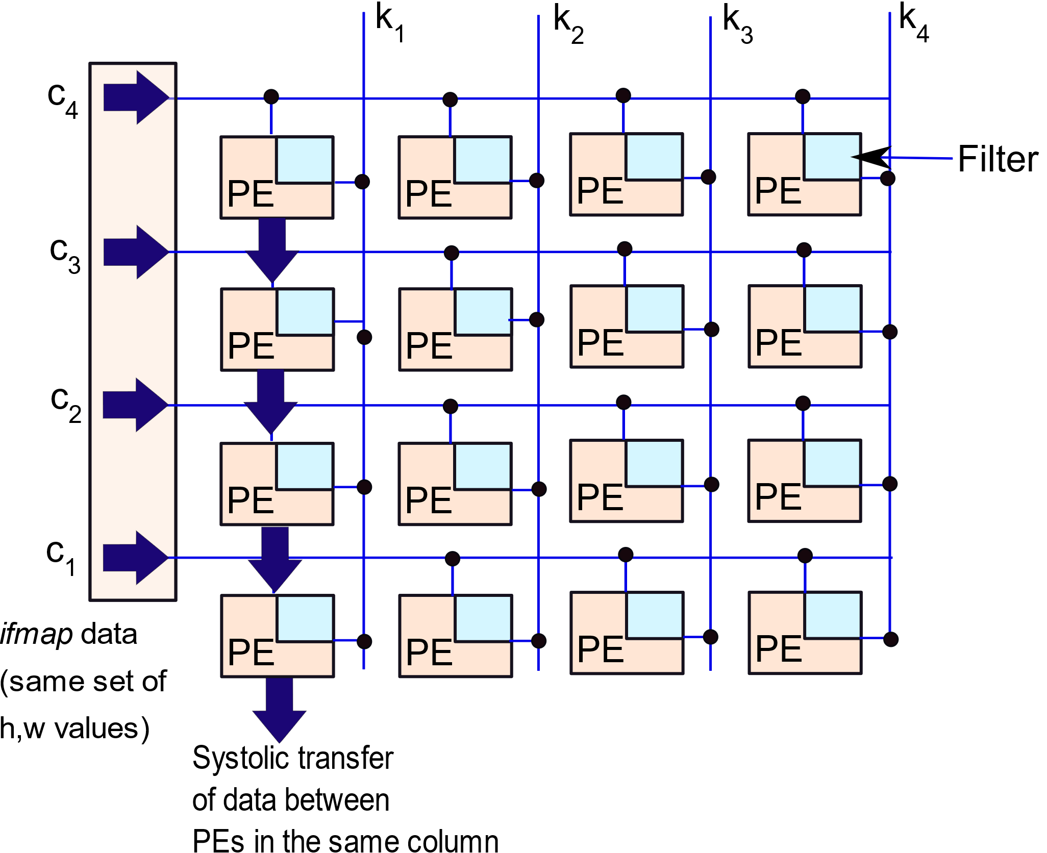
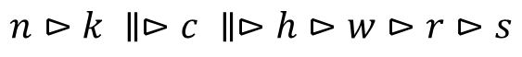
WS Architecture
$$n⊳k ∥⊳c ∥⊳h⊳w⊳r⊳s$$

Slide 50
Phases
Phase I: Load the filter weights in each PE by reading the GB
Phase II: Send a block of pixels along each row (for each channel)
Phase III: Each PE computes the convolutions
Phase IV: Add the values produced by each column
Have a tree of adders that can add the values
Perform a systolic transfer between PEs (columnwise)

Slide 51
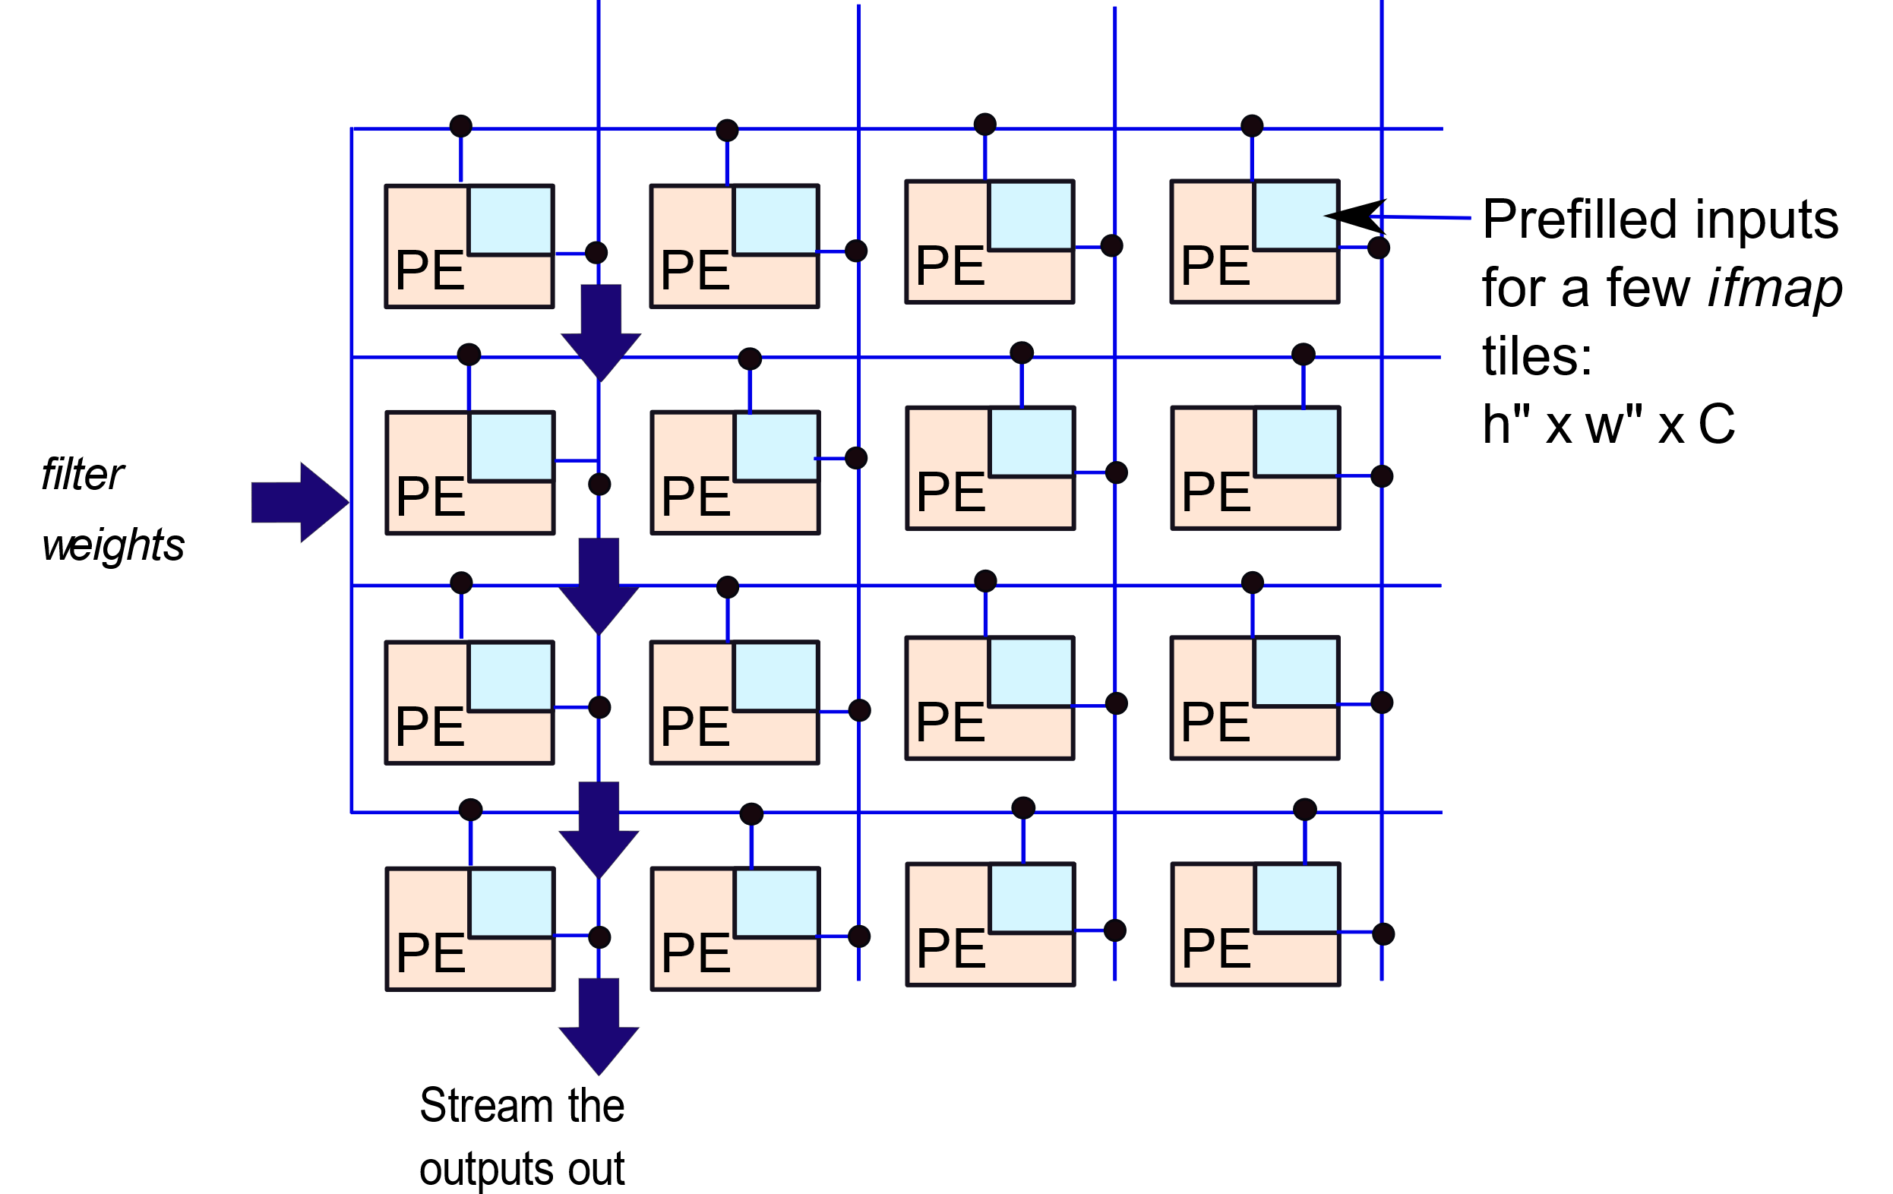
IS Architecture
$$n⊳h^{′}∥w^{′}∥k⊳r⊳s⊳c⊳h^{′′}⊳w′′$$

Slide 52
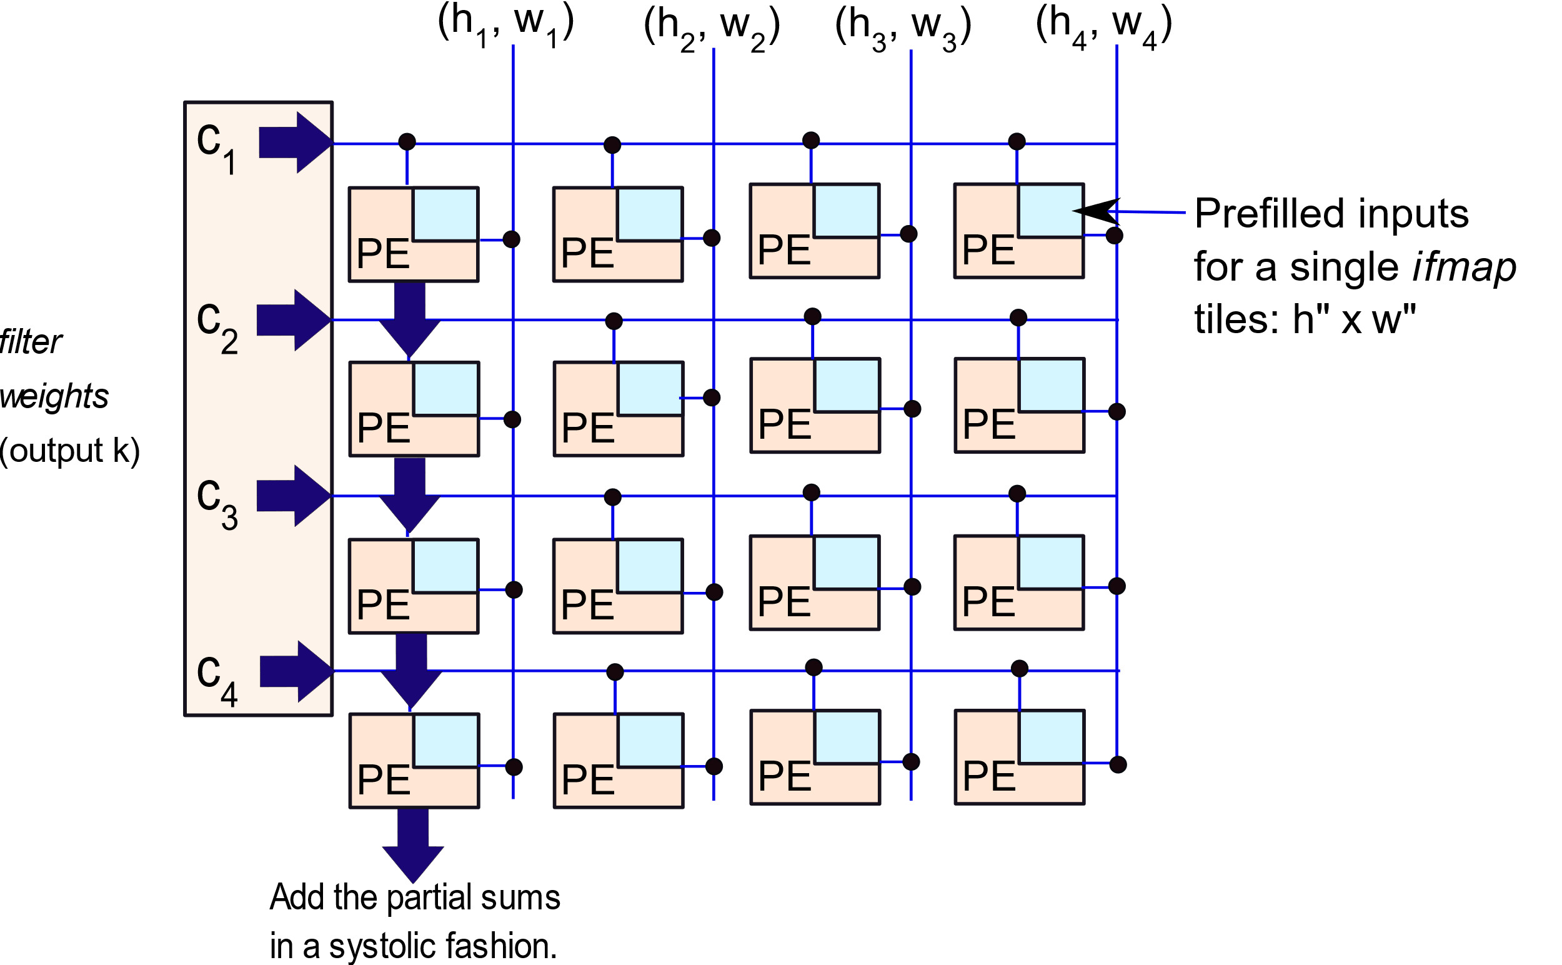
IS Architecture: Columnwise Reduction
$$n⊳h^{′}∥w^{′}∥⊳c∥k⊳r⊳s⊳ h^{′′}⊳w′′$$

Slide 53
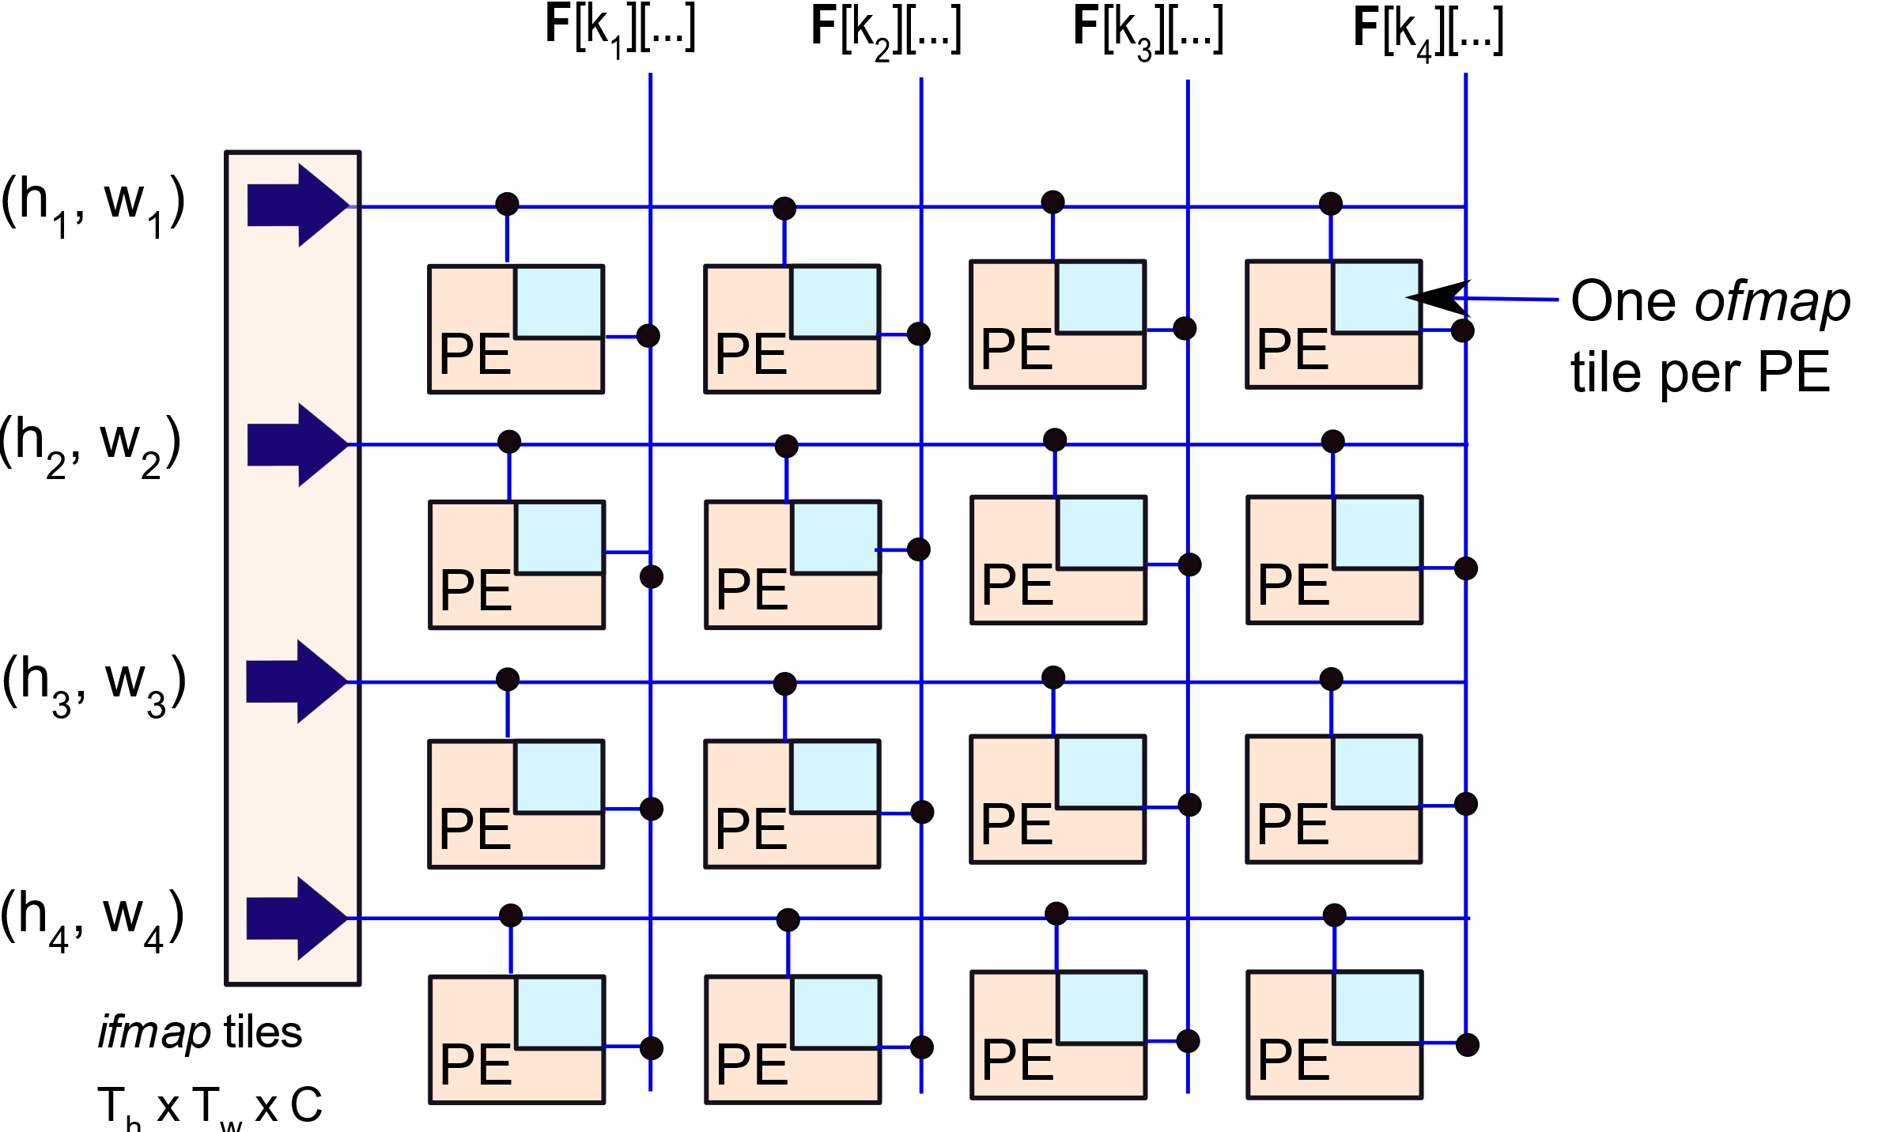
OS Architecture
$$n⊳h^{′}∥w^{′}∥⊳k∥c⊳r⊳s⊳ h^{′′}⊳w′′$$

Slide 54
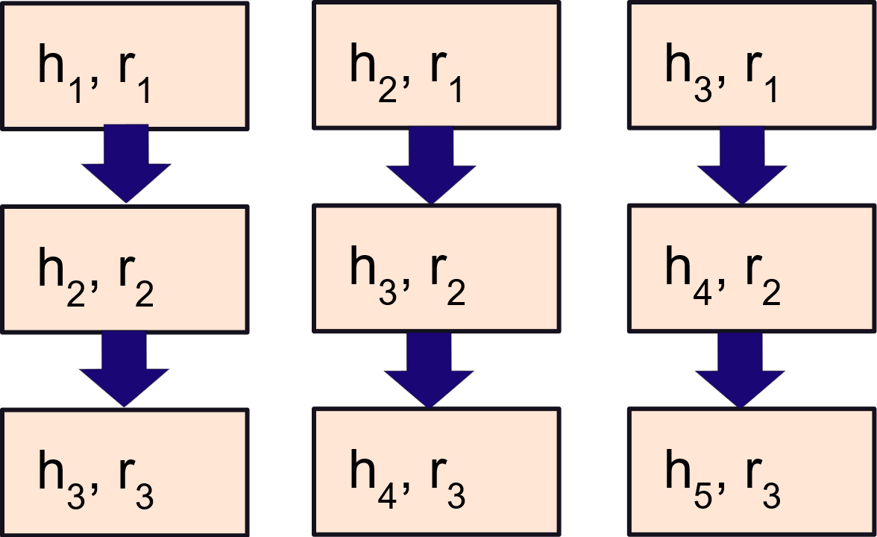
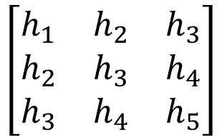
RS Architecture
Flow of actions.
The arrangement of data can be represented as a matrix.
$$\left[\begin{matrix}h_{1} & h_{2} & h_{3} \\ h_{2} & h_{3} & h_{4} \\ h_{3} & h_{4} & h_{5}\end{matrix}\right]$$

Slide 55
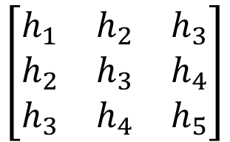
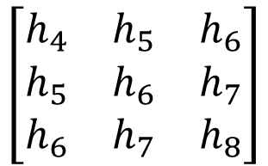
RS Architecture – II
In the next cycle we process a different matrix.
$$\left[\begin{matrix}h_{1} & h_{2} & h_{3} \\ h_{2} & h_{3} & h_{4} \\ h_{3} & h_{4} & h_{5}\end{matrix}\right]$$
$$\left[\begin{matrix}h_{4} & h_{5} & h_{6} \\ h_{5} & h_{6} & h_{7} \\ h_{6} & h_{7} & h_{8}\end{matrix}\right]$$
The ifmap rows or the filter weights need to move around.
This computation is only for a single input channel and filter pair.
We need to do this for every ifmap-ofmap pair
We thus need to have many parallel units for performing these operations.
Advantage: A PE can process more data at once.

Slide 56

RS Architecture – Full System
$$n⊳k∥c∥⊳h^{′}∥r^{′}∥h′′⊳r^{′′}⊳w⊳s$$
Representation of computations for the entire system.
First parallelize based on input-output channels
Then parallelize on the basis of filter and ifmap rows
In each PE: iterate through a row of the ifmap and filter
Compute a 1D convolution
We essentially need a bunch of 1D convolution units

Slide 57
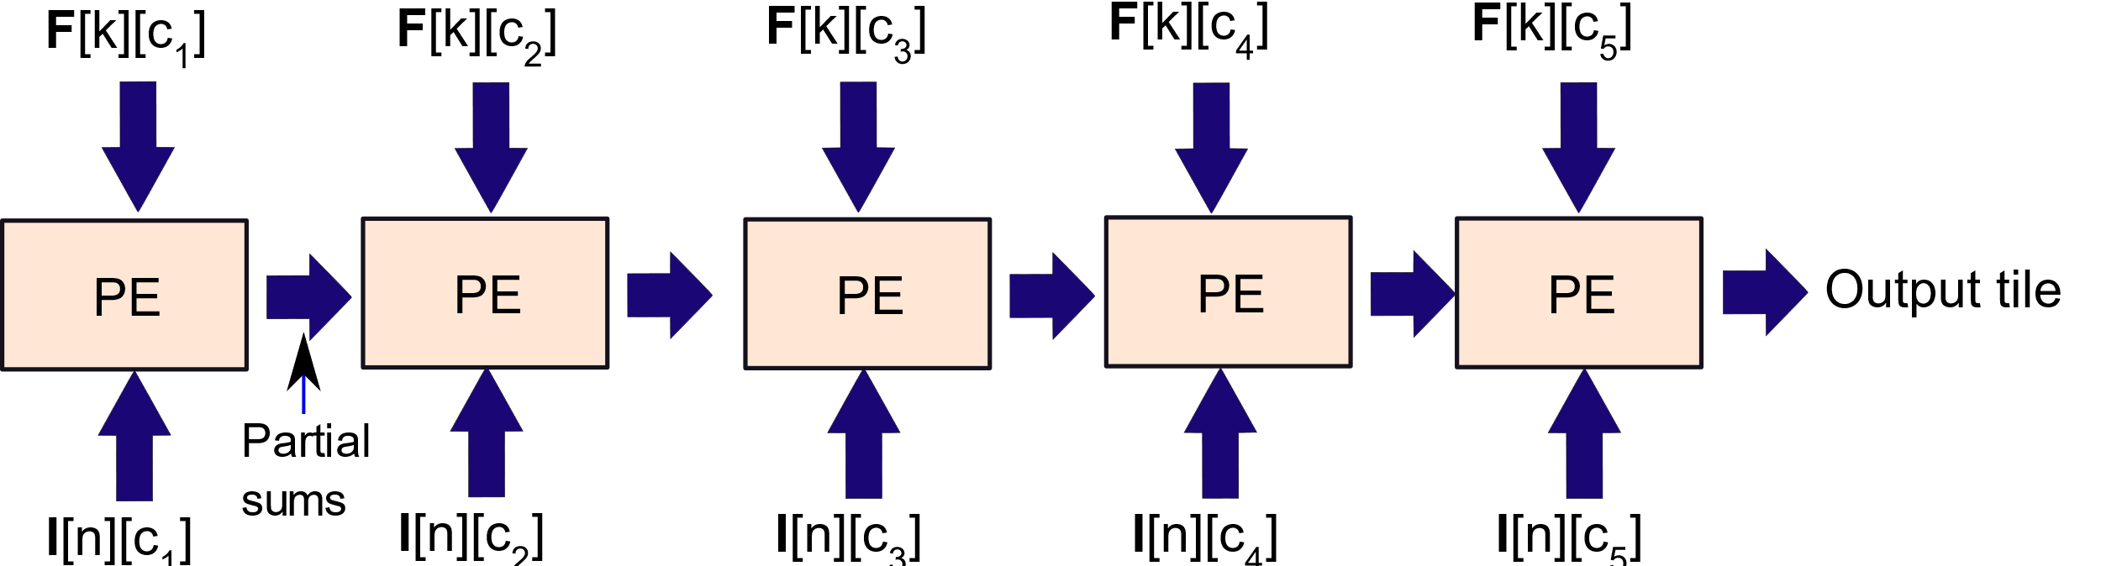
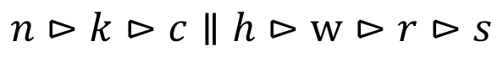
NLR (No Local Reuse)
$$n⊳k⊳c∥h⊳w⊳r⊳s$$
No data is stored in any PE.
We simultaneously compute convolutions for each input channel
Then the results are aggregated in systolic fashion
Reuse is inversely proportional to the communication

Slide 58
1.
Basics of Deep Learning
2.
Design of a CNN
3.
Intra-PE Parallelism
4.
Optimizations
5.
The Memory System

Slide 59

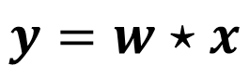
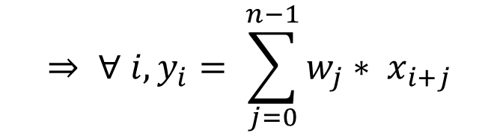
Intra-PE Parallelism
$$y=w⋆x$$
$$⇒ ∀ i, y_{i}= \sum_{j=0}^{n−1}{w_{j}∗ x_{i+j}}$$
Let us look at the convolution process within a PE
Let us first consider the simpler case of a 1D convolution
A 2D convolution can be broken down into a series of 1D convolutions.
How can we create an efficient design for implementing
a 1D convolution?

Slide 60

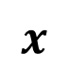
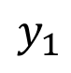

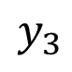
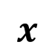


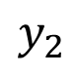
Visualization of a Convolution
A convolution is a sliding-window based convolution.
$$x$$
$$w$$
1
2
3
$$x$$
$$∗$$
$$∗$$
$$∗$$
Slight abuse of notation: Let us start the count from 1
$$y_{1}$$
$$y_{2}$$
$$y_{3}$$

Slide 61

Semi-systolic Array

Slide 62
Problems with this Design
The MAC (multiply accumulate) units are very fast.
The registers are made of fast flip-flops.
However, the adder tree maybe slow. It depends on the number of inputs.
Since the adder tree is one combinational unit, its delay has to be less than one clock period.
This restriction will unnecessarily increase the clock period
We want all the clock stages to be balanced

Slide 63
One more idea of a semi-systolic architecture: Broadcast weights

Slide 64

Pros and Cons of this Design
Avoids a costly tree of adders
Quickly broadcasts weights to an array of MACs
They work in parallel
Main problem:
The long wire (for broadcasts) might have a large RC delay
This will lengthen the clock period
We need a more homogeneous architecture.
Systolic Architecture
There is always a register between two combinational units (CUs).

Slide 65

Retiming Lemma
Can we automatically convert a semi-systolic array into a systolic array?
Convert the previous network to a form that avoids broadcast connections.

Slide 66
Create a graph-based representation.
The CUs are the nodes.
CUs are connected by edges. The weight of each edge is the number of registers on it.
1
1
1
1
1
1
Host
0
0
0
0
0
0
1
1
1
1
1

Slide 67
Properties of such Graphs
Semi-systolic networks have edges with weight 0
All the edge weights are non-negative and there are no zero-weight cycles
0-weight edges indicate broadcast connections and direct connections between CUs.
These are not allowed in systolic networks.
All the edges should have a weight of 1 (at least).
This means that there should be a register between two CUs or the host and a CU.
The process of converting a semi-systolic graph to a systolic graph is known as retiming.

Slide 68

Basic Idea of Retiming
0
k
0
-k
0
k
0
0
k
-k
We are adding a lag of k.
Add k to all incoming edges. Subtract k from all outgoing edges.
Other nodes do not perceive the difference.

Slide 69

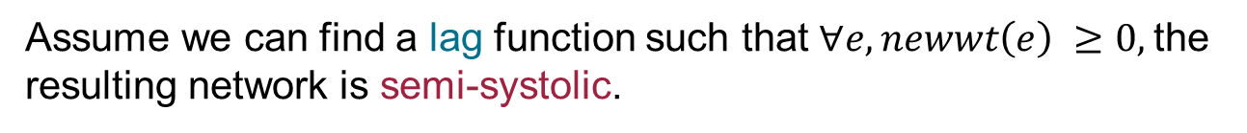
Effect of Lags on Edge Weights
tail
head
$$newwt\left(e\right)=oldwt\left(e\right)+lag\left(head(e)\right)−lag (tail\left(e\right))$$
Theorem
Assume we can find a lag function such that $∀e, newwt\left(e\right) ≥0,$the
resulting network is semi-systolic.
Easy to prove that there are no zero-weight cycles in the resulting
network because the original network did not have one.

Slide 70
Systolic Conversion
Consider a semi-systolic network G.
Now, compute G – 1.
Just subtract 1 from each edge weight
Assume it does not have a negative weight cycle
lag(v) = weight of the shortest path from v to the host in (G – 1)

Slide 71


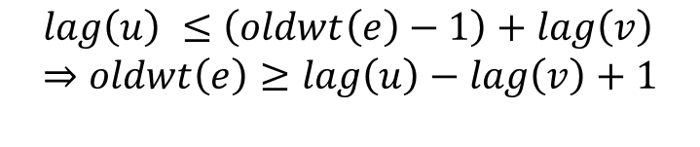
Systolic Conversion – II
u
v
Weight of edge e (u → v) in G – 1 is oldwt(e) – 1. Now, we have superimposed a lag function on it. Since the lag function corresponds to shortest paths, we have.
$$lag\left(u\right) ≤\left(oldwt\left(e\right)−1\right)+lag\left(v\right) \\ ⇒oldwt\left(e\right)≥lag\left(u\right)−lag\left(v\right)+1$$
Let us define the new weight of the edge as:
$$newwt\left(e\right)=oldwt\left(e\right)+lag\left(v\right)−lag \left(u\right) \\ ≥1$$
The new network is systolic.

Slide 72

What if there is a negative weight cycle in G - 1?
In this case, we need to slow down the network.
We first create the network kG
Multiply each edge weight by k
Choose the smallest k such that
kG – 1 does not have a negative weight cycle.
What is the implication of this?
Answer:
The rate of production of outputs reduces by a factor of k

Slide 73
Example: 1D Convolution
1
1
1
1
1
1
Host
0
0
0
0
0
0
1
1
1
1
1
Graph G

Slide 74
Example: 1D Convolution
0
0
0
0
0
0
Host
-1
-1
-1
-1
-1
-1
0
0
0
0
0
Graph G-1
There are negative-weight cycles.

Slide 75

Example: 1D Convolution
1
1
1
1
1
1
Host
-1
-1
-1
-1
-1
-1
1
1
1
1
1
Graph 2G-1
No negative-weight cycles.

Slide 76
Example: Nodes annotated with the lag function values
1
1
1
1
1
1
Host
-1
-1
-1
-2
-1
-3
-1
-4
-1
-5
-1
-6
1
1
1
1
1
Graph 2G-1
No negative-weight cycles.

Slide 77
Example: Systolic Array after Retiming
2
2
2
2
2
2
Host
1
1
1
1
1
1
1
1
1
1
1
Note that the original graph has changed from G to 2G
The new weights are added.
This is a systolic network.

Slide 78
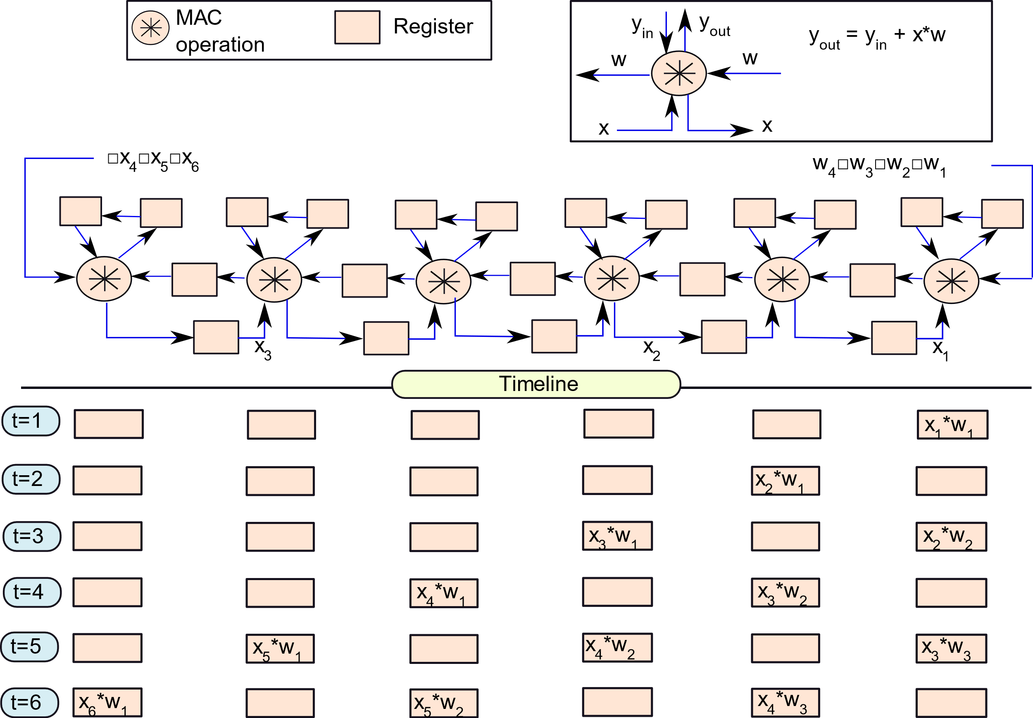
Equivalent Systolic Network

Slide 79
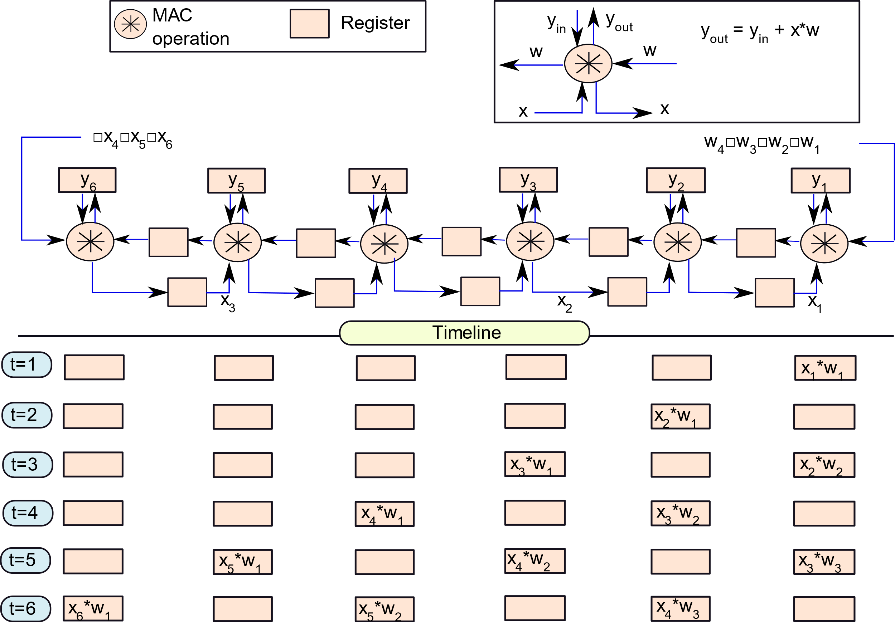
Practical Realization: Activate functional units only when there is valid data

Slide 80

Quick Commentary
The □ symbol indicates an empty symbol (no data).
The network pretty much runs at half the speed.
Assume that the functional unit is active only when there is valid data.
We can increase it. First consider the original systolic network.

Slide 81
Equivalent Systolic Network
Convolution 1
Convolution 2

Slide 82
Two Parallel Computations
Interleave two convolutions
This will properly utilize the idle cycles.
There are two registers with each CU
Each one can hold the state for 1 pixel of each convolution
We can extend this idea to graphs of the form kG
If we tile the computations, it is easy to find opportunities for such interleaving within each PE
Given the efficiency of such networks, 1D convolutions are quite fast.
This is one reason for the efficiency of row stationary computations.

Slide 83
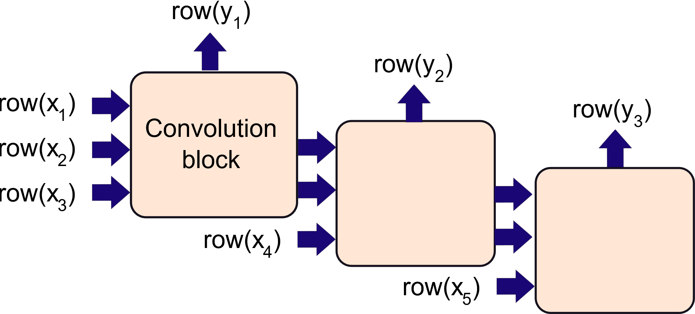
2D Convolutions: Simple Method
Cascaded computations
Each convolution block performs a series of 1D convolutions

Slide 84
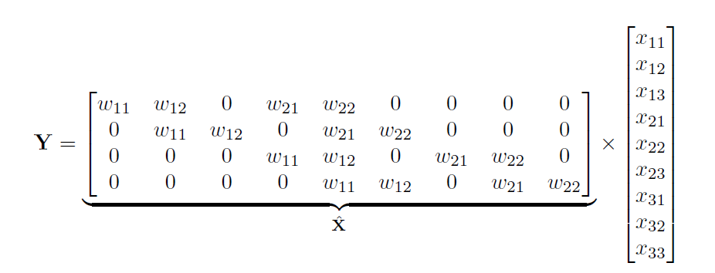

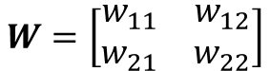
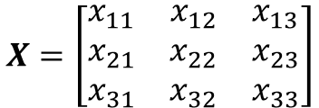
Matrix-based Approach for 2D convolution
Direct product method
$$X=\left[\begin{matrix}x_{11} & x_{12} & x_{13} \\ x_{21} & x_{22} & x_{23} \\ x_{31} & x_{32} & x_{33}\end{matrix}\right]$$
$$W=\left[\begin{matrix}w_{11} & w_{12} \\ w_{21} & w_{22}\end{matrix}\right]$$
$$\hat{W}$$
$\hat{W}$ is known as a doubly block-circulant matrix.
Uses fast accelerators for matrix multiplication.
We can also use GPUs.

Slide 85
1.
Basics of Deep Learning
2.
Design of a CNN
3.
Intra-PE Parallelism
4.
Optimizations
5.
The Memory System

Slide 86
Optimizations
Modern CNNs have millions of weights
The inference times can be significant.
There is a need to speedup this process
Identify ineffectual operations (operations that can be discarded without affecting the final outcome)
Remove them
Reduce the memory bandwidth and memory footprint
Compress weights and input data
Leverage redundancy
Do not store 0 values
Reduce the precision of operands

Slide 87

Common Subexpression Elimination
Expression
$$wx_{1}+wx_{2}+w^{′}x_{3}+w^{′}x_{4}+w^{′′}x_{5}+w^{′′}x_{6}+w^{′′}x_{7}$$
7 multiplications, 6 additions
Optimized Expression
$$w{∗(x}_{1}+ x_{2})+w^{′} ∗\left(x_{3}+ x_{4}\right)+w^{′′}∗(x_{5}+x_{6}+x_{7})$$
3 multiplications, 6 additions
We reduce 3 multiplications.

Slide 88
Zero and Negative Values
Consider zero-valued weights and inputs
There is no need to perform a multiplication
We can create a bit-vector for each filter weight or ifmap.
If the corresponding bit (for a multiplication) is 1, we do the multiplication, else we skip it.
Reduces time and power
Negative values
Most convolutional units feed their ofmaps to ReLU layers
If we have a good estimate of the final product (dot product of an ifmap submatrix and the filter matrix), and it is going to be negative, then the computation can be terminated midway.
Use the more significant bits to get an estimate.

Slide 89
Problems with such Approaches
It is quite hard to do this in a rigid architecture like a systolic array.
However, if we consider large tile sizes it is possible to build bespoke circuits to identify such ineffectual computations
These optimizations are easy to perform when we are dealing with a large amount of data in one go
Row stationary architectures
Direct product method

Slide 90
Reduction in Memory Access Time
Compression
Base-delta compression
Consider 4 values 100, 101, 103, and 104
We set the base as 102.
The deltas are: -2, -1, 1, and 2 (resp.)
The storage space (in terms of bits) gets reduced drastically
Dynamic detection of zero-valued weights/inputs
We simply don’t store the 0 values
We use a separate bitmap to indicate the locations of the 0 values

Slide 91

Reduction of Precision
Should we use single-precision, double-precision or the fixed-point representation?
Different layers need different levels of precision
Different filters and different ifmaps need different levels of precision.
There is a need to dynamically study the behavior of a CNN and set the appropriate precision.
An important proposal in this space.
Bit-serial Arithmetic

Slide 92

Bit-Serial Arithmetic: Consider regular binary multiplication first
1 1 0 1
Consider regular binary
Multiplication first
A
1 0 1 1
B
1 1 0 1
1 1 0 1
Partial sums
0 0 0 0
1 1 0 1
$$A_{4}∗B_{1}+A_{3}∗B_{2}+A_{2}∗B_{3}+A_{1}∗B_{4}$$
Looks like a 1D convolution

Slide 93


Bit-Serial Multiplication – II
Every column in the binary multiplication represents a 1D convolution
In the example shown the sum of the indices = 5
If you look at the rest of the columns, they have different sums:
2,3,4,5,6,7,8 (respectively)
The final product can be thought of as a 1D convolution of the two bit vectors: A and B
Not quite: We are not taking carrys into account
If we allow the carrys to ripple through, then the product is correct.
In a systolic architecture of this nature, the inputs flow in to the
circuit, bit by bit.

Slide 94
Other Bit-Serial Architectures
There are many kinds of bit-serial architectures
Simple design
If we are multiplying A * B
Read in B , bit by bit
If a bit is 1, then only, add A to the partial product
Another method
Divide the multiplier, B, into chunks of m bits
For a chunk, discard the 0s at the beginning and end
Multiply the reduced value with A
Scale the result and add to the partial product.
Easy to take care of ineffectual values.

Slide 95
1.
Basics of Deep Learning
2.
Design of a CNN
3.
Intra-PE Parallelism
4.
Optimizations
5.
The Memory System

Slide 96
Push and Pull-based System Design
Consider a 16 x 16 PE array
We need 16 streams for the rows and 16 for the columns
Total: 32 memory streams
Pull-based mechanism
Whenever there is a miss, we pull in data into the LBs and GBs
This is impractical in CNNs → will lead to many stalls
Moreover, the computation is deterministic
Push-based mechanism
The smart dispatcher needs to coordinate the computation and
Prefetch data

Slide 97
Example with Prefetching (the prefetch code is not shown, the comments indicate the location)
for (n=0; n<N; n++) { /* input images */
// load the nth image I[n] in the DRAM
parallel for (h1 =0; h1 <H; h1 += Th) {/* rows : ifmap / ofmap */ parallel for (w1 =0; w1 <W; w1 += Tw) {/* cols : ifmap / ofmap */ // load the output tile at O[n][k][ h1 ][ w1] in each LB
parallel for (k=0; k<K; k++) { /* outputs */ for (c=0; c<C; c++) { /* input channels */ // load the filter F[k][c] in the GB // load the input ifmap at I[n][c] in the GB
for (r=0; r<R; r++) { /* rows of the filter */ for (s=0; s<S; s++) { /* cols of the filter */
for (h2=h1; h2 <h1+Th; h2 ++) { for (w2=w1; w2 <w1+Tw; w2 ++) {
O[n][k][ h2 ][ w2] += I[n][c][ h2+r][ w2+s] * F[k][c][r][s];
}}}}}}}

Slide 98

Processing in Memory (PIM)
Use the analog nature of electronic devices for realizing dot products.
Consider an array-based memory design.
Let the electrical parameters of each cell be controlled by the voltage of the word line
There are two broad paradigms: charge sharing and current summing

Slide 99
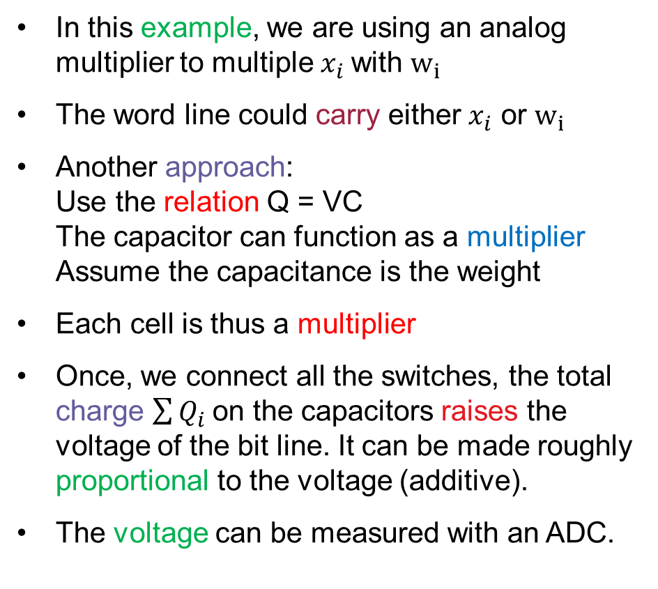
Charge Sharing
In this example, we are using an analog multiplier to multiple $x_{i}$with $w_{i}$
The word line could carry either $x_{i}$ or $w_{i}$
Another approach: Use the relation Q = VC The capacitor can function as a multiplier Assume the capacitance is the weight
Each cell is thus a multiplier
Once, we connect all the switches, the total charge $\sum{Q_{i}}$on the capacitors raises the voltage of the bit line. It can be made roughly proportional to the voltage (additive).
The voltage can be measured with an ADC.

Slide 100

Charge Sharing vs Current Summing
We can do the same with current.
Ohm’s law: V/R = I
We are multiplying the voltage with the conductance (1/R)
The current will get summed.
This is effectively a dot product.

Slide 101

Implementation Techniques
We can use regular CMOS transistors as multipliers by operating them in their linear region.
Resistive RAMs (ReRAMs) are the most suitable for such applications.
Their resistance can be easily varied by changing the voltage across the cell.
We can then use either charge sharing or current summing.
Such circuits are known as neuromorphic circuits.

Slide 102
Conclusion
CNN-based deep neural networks are one of the most popular machine learning technologies.
The convolutional layer is the most performance sensitive
layer.
There are five kinds of architectures: IS, OS, WS, RS, and NLR. Key concepts in accelerator design: tiling, caching, and parallelism.
Any semi-systolic array can be converted to an equivalent systolic array using retiming.
ReRAM-based neuromorphic circuits can be created
using charge sharing and current summing.

Slide 103
The End

